Slide 1
Human Toll 1
Heimaey, Iceland 1973 Eruption

Slide 2
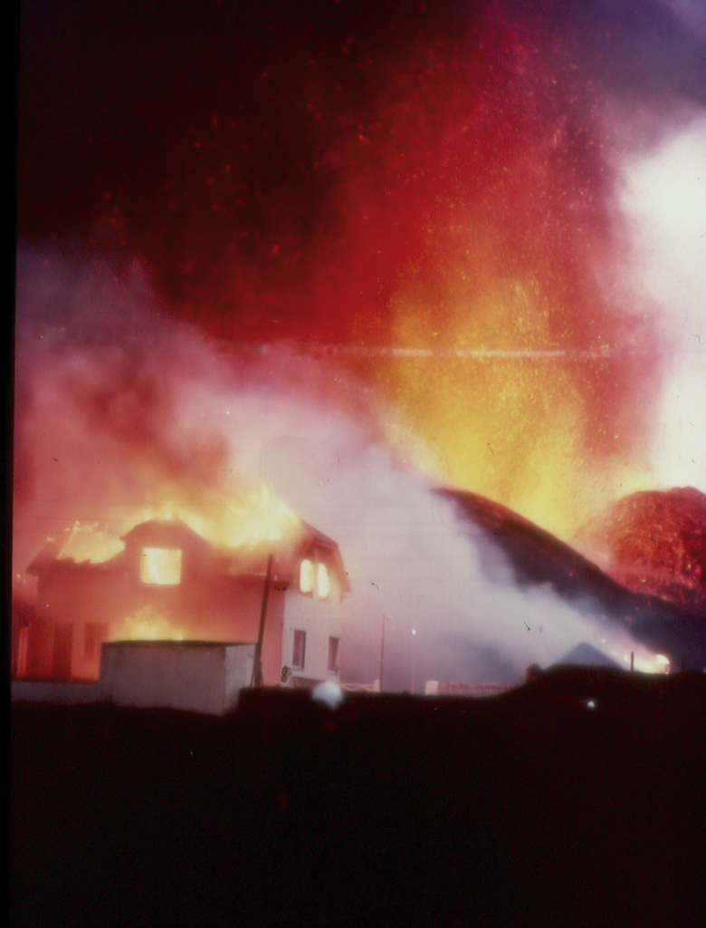
Economic Impacts
400 buildings were destroyed.
Heimaey accounts for approximately 3 per cent of Iceland's total GNP and 8 percent of exports. [4]
10.2 billion Kronur in damages which was almost 13 percent of 1973’s GNP [4].
For reference, in 1973, the exchange rate was 88 Kronur to $1 USD. [4 p.11]
That’s $11.6 million USD or $62.1 million USD with inflation. [5]
Figure 4

Slide 3
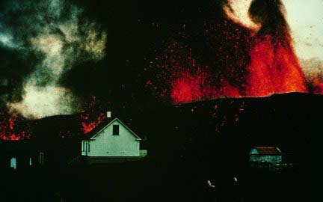
Casualties
There was only one fatality. A man died of carbon monoxide poisoning from the eruption. [1,2]
Figure 5

Slide 4
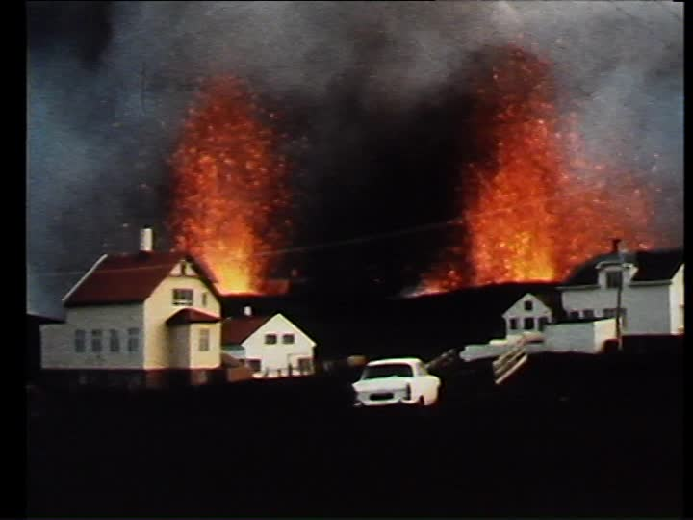
Injured
There is no official record of a
single injury caused by this eruption.
Wikipedia asserts (without a citation)
that several people sustained minor
burns while combatting the lava flow
with seawater. [3] *
* Wikipedia is not a reliable source. This citation is provided only for the sake of completeness.
Figure 3

Slide 5
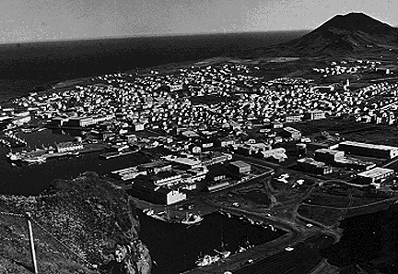
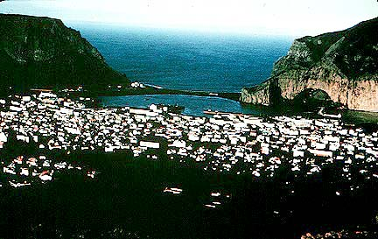
Homeless or Displaced
Heimaey was a fishing town with a population of 5300 residents. [1,2]
The entire town was evacuated, with some 250 volunteers staying behind to help prevent destruction. [1,2]
Only 2000 of the 5300 residents had moved back to Heimaey by the end of 1973 [1]
Figure 1 - Before
Figure 2 -After

Slide 6
Bibliography
[1] http://www.geo.mtu.edu/volcanoes/boris/mirror/mirrored_html/Heimaey.html
[2] http://www.cnn.com/2014/07/07/travel/iceland-pompeii/
[3] https://en.wikipedia.org/wiki/Eldfell#Lava-cooling_operations *Wikipedia is not a reliable source. This citation is provided only for the sake of completeness.
[4] http://rafhladan.is/bitstream/handle/10802/9623/1061031e-1973.pdf?sequence=11 page 24
[5] http://www.bls.gov/data/inflation_calculator.htm
Figure 1,2 http://geo.web.ru/Lectures/Plechov/lecture-1/Eldfell.htm
Figure 3 http://footage.framepool.com/shotimg/qf/193530412-eldfell-heimaey-molten-eruption-column.jpg
Figure 4 https://c2.staticflickr.com/8/7004/6785065085_7d34bae68d_b.jpg
Figure 5 http://geo.web.ru/Lectures/Plechov/lecture-1/Eldfell_files/H26.jpg

